Slide 1
FIRST THINGS FIRST

Slide 2
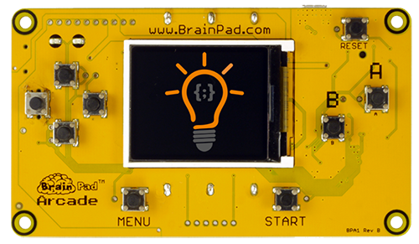
What is a BrainPAD?
LOAD/RESET
USER BUTTONS
COLOR DISPLAY
USER BUTTONS
Notes:
A BrainPad is a circuit board designed to spark a person's knowledge to learn coding and electronics. 1 & 2. On the front we have USER BUTTONS. These are used to run the programs we create and load. 3. The BrainPad is equipped with a color display. The games you make will appear here on the color screen. 4. Load and Reset button. This button is used to restart the BrainPad and to put into a mode that we can add our programs, more on that later.

Slide 3
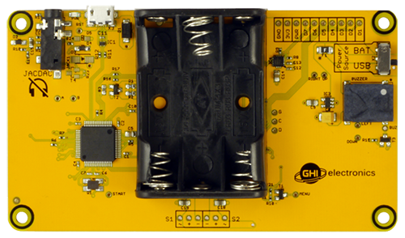
What is a BrainPAD?
POWER SWITCH
MULTI-PLAYER (JACDAC)
USB CONNECTOR
BUZZER
BATTERY PACK
THE BRAIN
Notes:
The back of the BrainPad shows us the components that make up the BrainPad. The first thing we see is a thing called JACDAC. This port is used to connect 2 BrainPad’s together. Once connected both BrainPad’s can be used to play 2 player games. 2nd is the USB connector. This is how we will load the games onto our BrainPad through the computer. This is the Brain of the BrainPad. This is the actual chip that is holding the programs we create. The BrainPad is equipped with a battery pack so you can take the games you create with you anywhere. 5th is a Buzzer, the sounds we create in our games play here. Lastly is a power switch. This switch is used mostly when the BrainPad is running on batteries, so that it can be turned off when not in use.

Slide 4
SAFETY FIRST
Notes:
The BrainPad Circuit board itself may contain rough edges. DO NOT GRAB out of someone's hands. Do NOT submerse or place the BrainPad in water. It is an electronic device and will damage the board. Do NOT use anything metal on the BrainPad, this could cause the BrainPad to short out and no longer work.

Slide 5
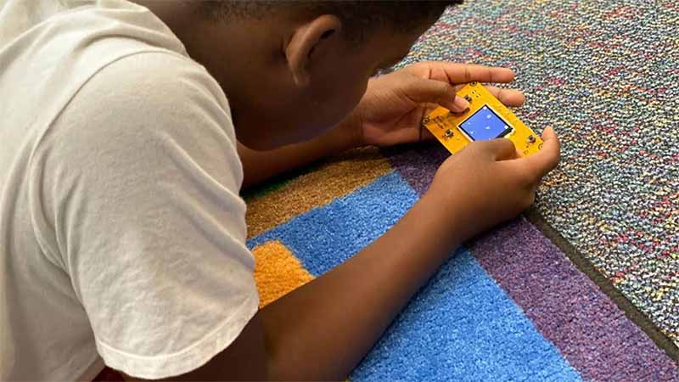
DON’T WORRY…You won’t GET electrocuted and it won’t Bite You!
Notes:
But don’t worry the BrainPad circuit won’t shock you. The electricity running is very low only 3.3v. You can pick it up and hold it in your hand and play the games.

Slide 6
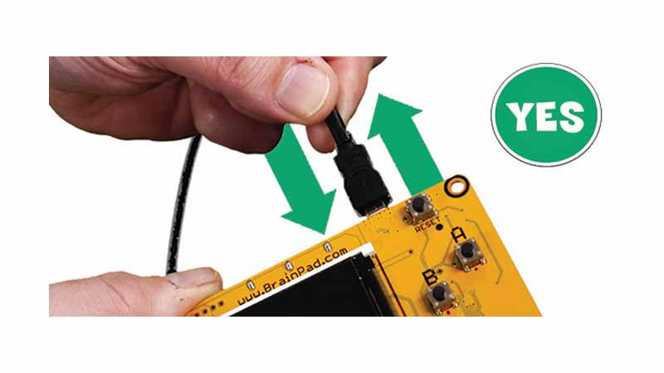
When Inserting or removing PULL or PUSH
Notes:
When connecting the BrainPad to a compute we use a microUSB cable. The USB cable should always be pushed or pulled straight in or out.

Slide 7
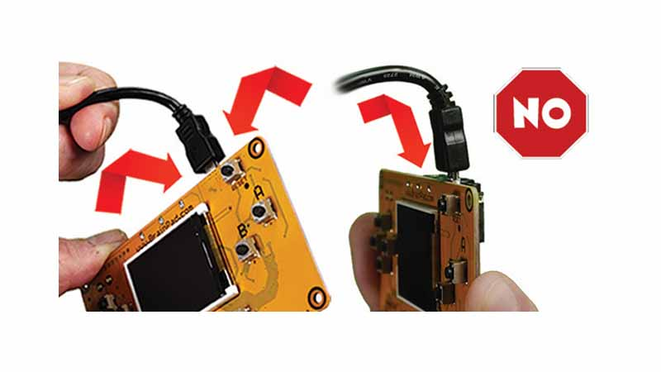
DO NOT TWIST or BEND the USB CABLE
Notes:
Never twist or bend the cable sideways when removing. This could break off the connector, breaking your BrainPad.

Slide 8
Notes:
Let’s add our first game to the BrainPad. First, we need to tell the BrainPad it’s time to LOAD a program. The first time you plug in a USB cable you may see the bootloader screen already. If you don’t then you can put the BrainPad into loader mode by pressing the RESET button for a moment until you see the LOADER SCREEN and the LED turns RED. Your BrainPad is now ready for a new game.

Slide 9
www.arcade.makecode.com
Notes:
Next open a browser window and navigate to www.arcade.makecode.com. Once you arrive there, scroll down to ‘Block Games’ section. Let’s click on the one titled ‘Space Destroyer’. Next click Open Example, Once loaded click on the large Download button at the bottom left of your screen. Select the BrainPad Arcade hardware. This start the download of the file we will be putting onto the BrainPad. In the previous step we put the BrainPad into ‘LOADER’ mode. This should have opened up a window on the computer. Next drag the newly created MakeCode file into the WINDOW the loader opened. Once the file transfers the GAME will be on the BrainPad.

Slide 10
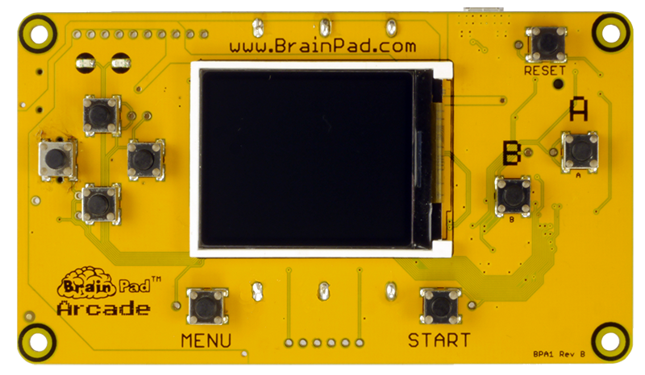
Notes:
The game is now loaded and ready to play! Any time you want to add a different game or one that you made, repeat the previous steps and drag the newly created file to the BrainPad WINDOW on the computer.

Slide 11
FALLING DUCK
CHICKEN RUN
JUMPY PLATFORMER
LET’S PLAY SOME OTHER GAMES
Enough Playing and Let’s Start Coding
Notes:
If we look around at the MakeCode website, we can see there are other games that can be download to the BrainPad. Take the time to look around and try to add a different game to the BrainPad.

